Slide 1
COMPUTER NETWORKS PROJECT: Chat Website
By:
Soham Rajendra (22BLC1146)
Krish Sahu (22BLC1171)
Arnav Vyas (22BLC1214)
Meghank Kishan (22BLC1290)

Slide 2
Features of our website:
User authentication
Chat / image sharing
Video call
Firebase for database
Vercel deployment

Slide 3
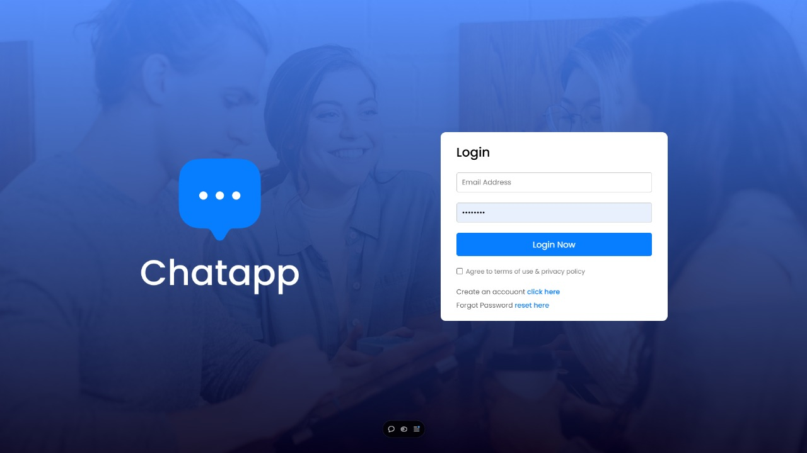
User Authentication:
Protocols:
HTTPS, OAuth2, OpenID Connect, HTTPS
(Hypertext Transfer Protocol Secure):Purpose: Ensures secure communication between the client (React frontend) and Firebase services during authentication.
How It Works: HTTPS encrypts data sent over the internet using TLS (Transport Layer Security). When a user logs in or signs up, sensitive data like passwords or tokens are encrypted, preventing unauthorized access during transmission.
OAuth2:Purpose: OAuth2 is a token-based protocol used to grant limited access to a user’s resources (e.g., their Firebase profile).
How It Works: When a user logs in with a third-party provider (e.g., Google), Firebase handles OAuth2 behind the scenes, issuing access tokens. These tokens represent the user's session, allowing access to restricted parts of the app without exposing passwords.
OpenID Connect: Purpose: Extends OAuth2 to add authentication capabilities. OpenID Connect manages user identity by verifying the token’s authenticity.
How It Works: Firebase Authentication uses OpenID Connect to handle user identity verification. When the user logs in, they receive an ID token from the provider, which Firebase uses to confirm the user’s identity.

Slide 4
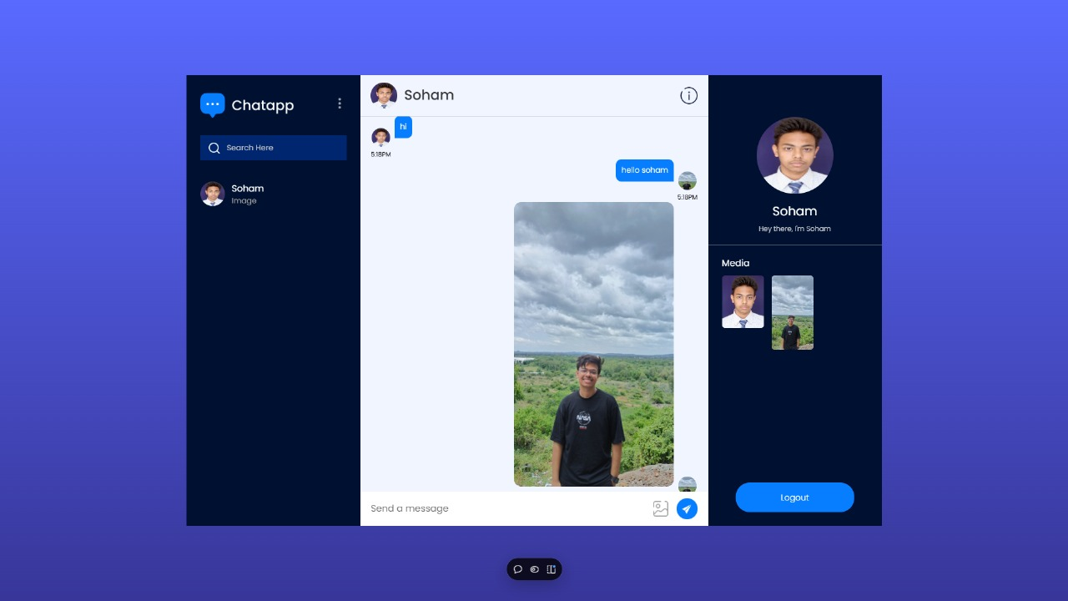
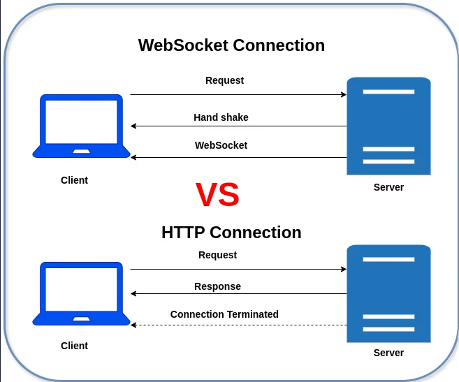
Real-Time Chat Functionality
Protocols:
WebSocket Protocol, HTTPS
WebSocket Protocol: Purpose: WebSocket enables persistent, two-way communication between the client and Firebase (or another server handling chat functionality).
How It Works: WebSocket establishes a single connection that remains open, allowing data to flow both ways in real-time. When a user sends a message, it’s transmitted instantly to the recipient through this continuous connection, which minimizes latency and avoids repeated HTTP requests.

Slide 5
Image Sharing
Protocols:
HTTPS
HTTPS: Purpose: Secures the transfer of images between the client and Firebase Storage.
How It Works: When a user uploads an image, the image data is encrypted and sent to Firebase Storage over HTTPS, protecting it from interception. Similarly, when another user accesses the image, HTTPS ensures secure download, preserving user privacy and data integrity.

Slide 6
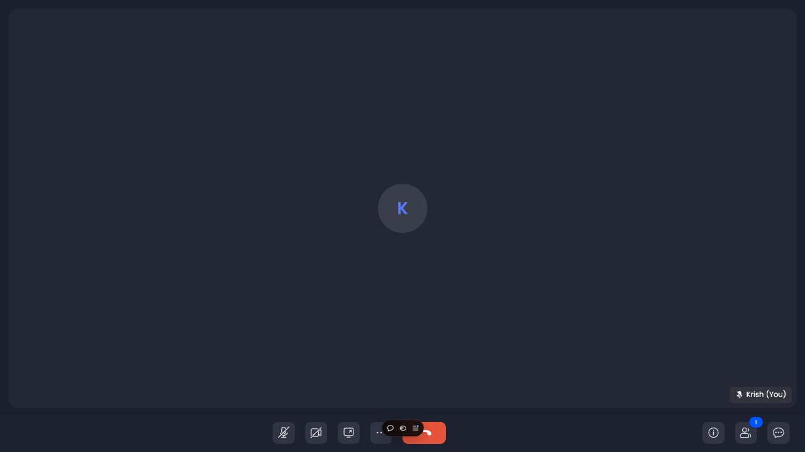
Video call
WebRTC Connection in a Video Call App
WebRTC (Web Real-Time Communication) is a set of protocols and APIs that enable real-time, peer-to-peer audio, video, and data communication between users directly within the browser. It is particularly suited for video call applications because it supports high-bandwidth, low-latency communication necessary for streaming audio and video.
How WebRTC Works in a Video Call App:
Peer-to-Peer Connection Establishment:
Unlike WebSockets, WebRTC enables a direct connection between peers (users) rather than relying on a server to relay messages.
To establish this connection, WebRTC requires an initial handshake process using signaling servers. The signaling process typically uses WebSockets or HTTP to exchange connection setup information.
Signaling Process:
ICE Candidates (Interactive Connectivity Establishment): Each client collects a list of network candidates (potential IP addresses) that could be used to establish a direct connection.
SDP (Session Description Protocol): The clients exchange media and codec configurations via the signaling server.
Once both peers exchange this information, they can find the best route for a direct peer-to-peer connection.

Slide 7
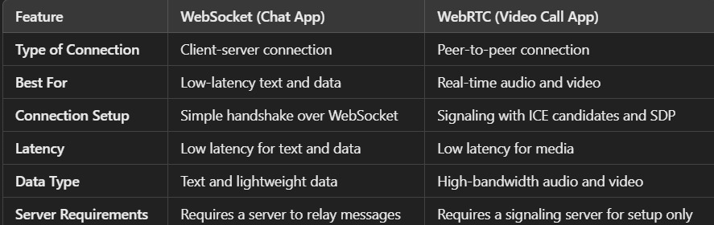
Media Streaming:
Once connected, WebRTC supports the secure, encrypted streaming of audio and video data directly between the two peers.
Video and audio streams are broken into smaller data packets and transmitted, allowing for real-time video and audio.
Handling Network Challenges:
WebRTC can adapt to varying network conditions by adjusting bitrate, frame rates, and resolution to ensure smooth video playback even with limited bandwidth.
Advantages of Using WebRTC for Video Calls:
Direct Peer-to-Peer Streaming: Video and audio data are streamed directly between users, reducing latency and server bandwidth usage.
High Bandwidth Support: WebRTC is optimized for transmitting high-bandwidth data like video and audio, enabling clear, real-time video calls.
Built-in NAT Traversal: WebRTC uses ICE and STUN/TURN servers to bypass firewalls and NATs (Network Address Translators), ensuring connectivity across different networks.

Slide 8
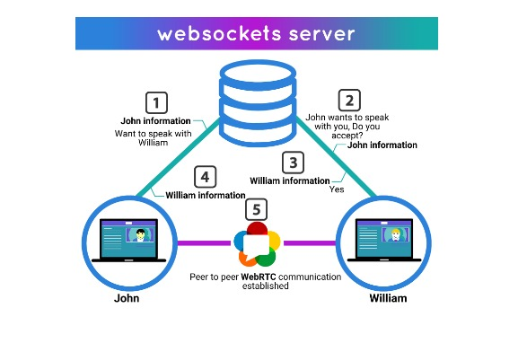
WebRTC uses UDP (User Datagram Protocol) as its primary transport protocol because of its low latency, making it ideal for real-time applications. UDP allows for quick data transfer without waiting for acknowledgments, which is critical for audio and video.

Slide 9
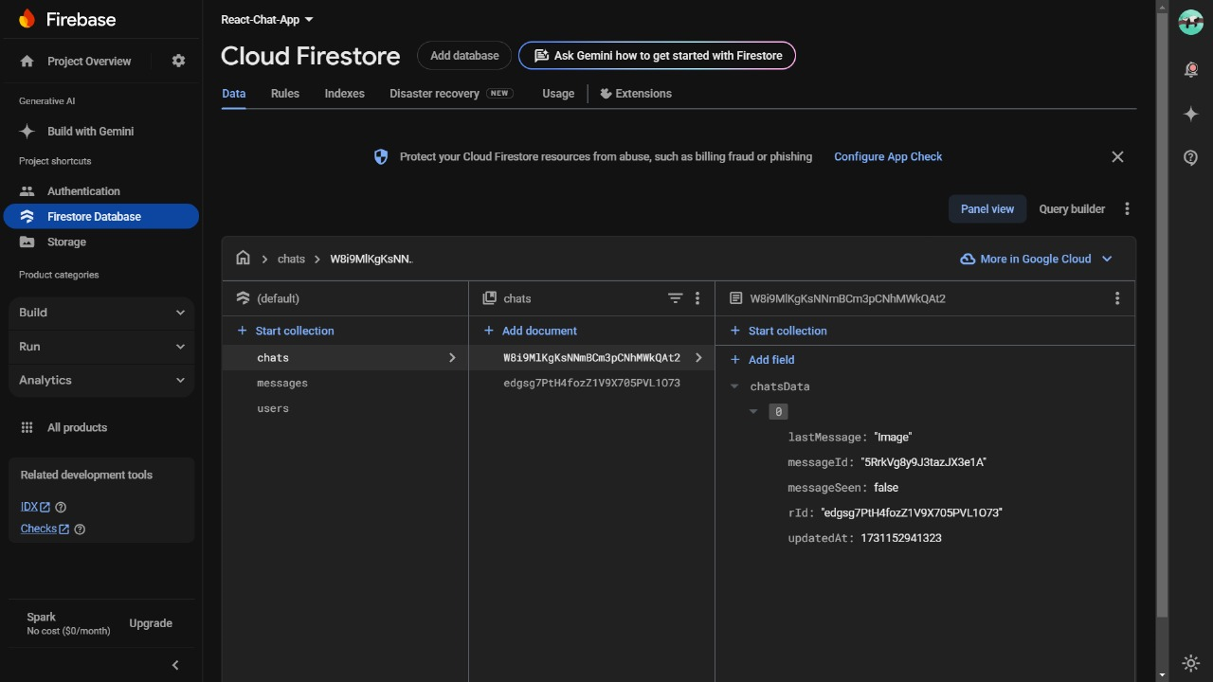
Firebase for database
Protocols:
WebSocket Protocol, HTTPS
WebSocket Protocol:
Purpose: Keeps chat messages and other data synchronized across devices in real-time.
How It Works: Firebase Firestore or Firebase Realtime Database typically uses WebSocket connections to sync data changes (like new messages or profile updates) instantly. When a user sends a message, it’s stored in the database and simultaneously pushed to other connected users via the WebSocket connection.
HTTPS:
Purpose: Initial data synchronization and offline caching.
How It Works: When users first log in, they fetch existing chat data over HTTPS. Firebase also uses HTTPS to send data when WebSockets are unavailable, falling back to polling techniques or other methods to sync data.

Slide 10
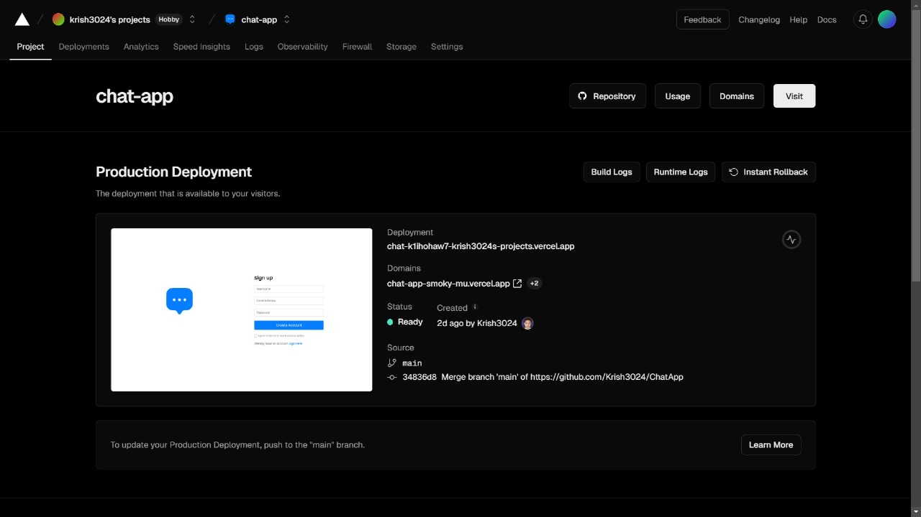
Vercel deployment
DNS (Domain Name System)
CDN (Content Delivery Network)
TCP/IP (Transmission Control Protocol/Internet Protocol)

Slide 11
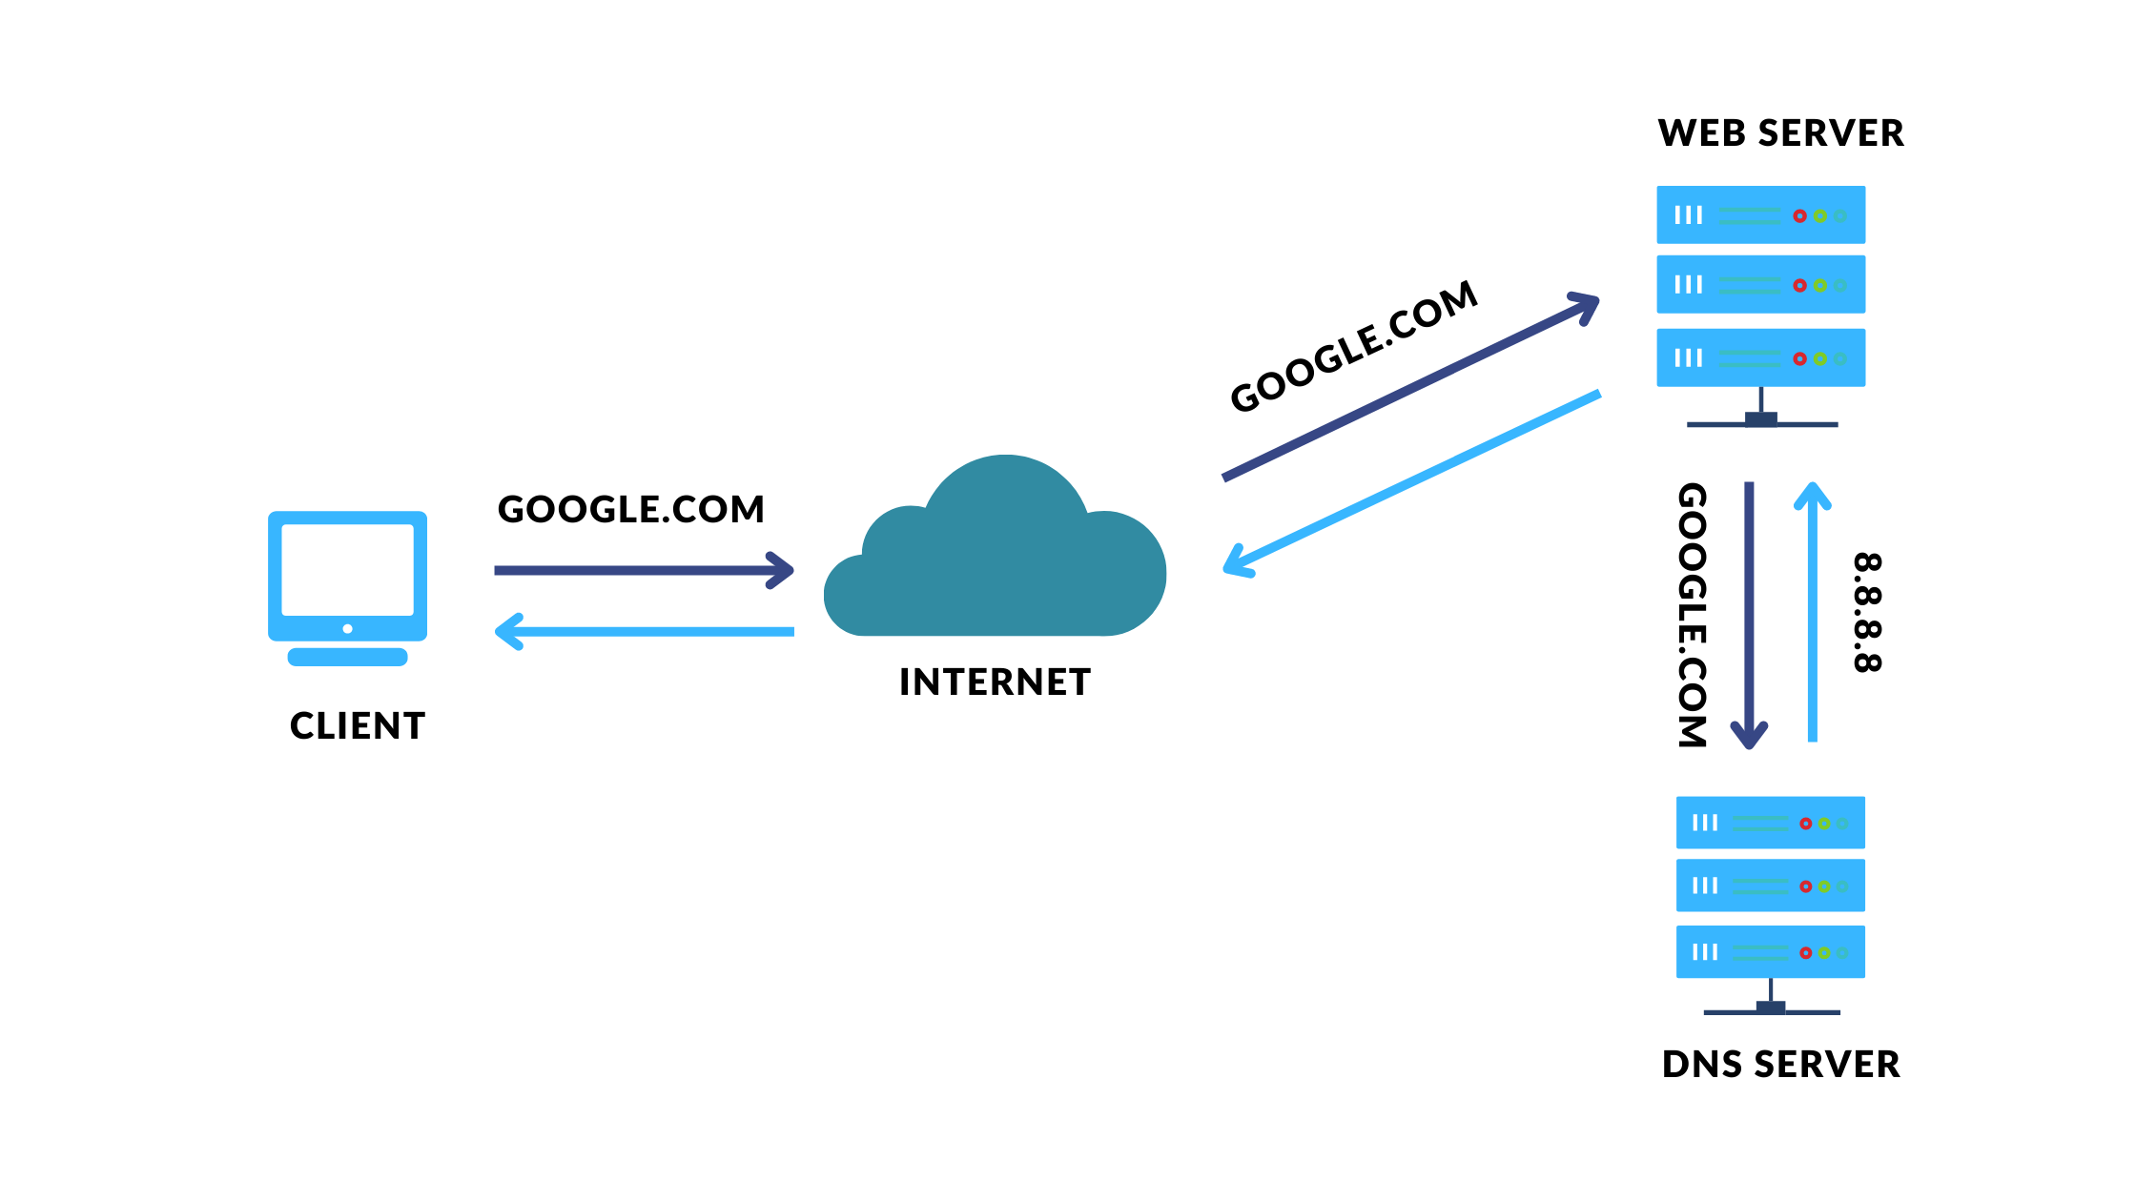
DNS (Domain Name System)
DNS translates domain names (e.g., example.com) into IP addresses that can be understood by machines.
When deploying on Vercel, you can configure custom domains, which involves setting up DNS records (such as A or CNAME records) to point your domain to Vercel's servers.

Slide 12
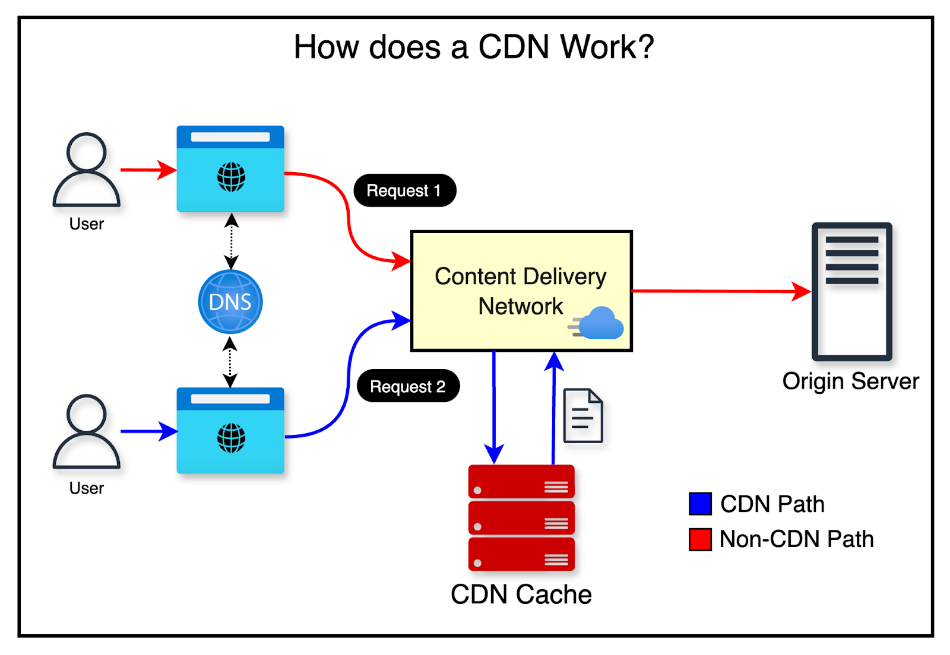
CDN (Content Delivery Network)
Vercel leverages a global CDN to deliver your website content faster to users worldwide.
CDNs cache your website’s assets (such as images, JavaScript, CSS) at various edge locations, reducing latency and improving load times for users regardless of their location.

Slide 13
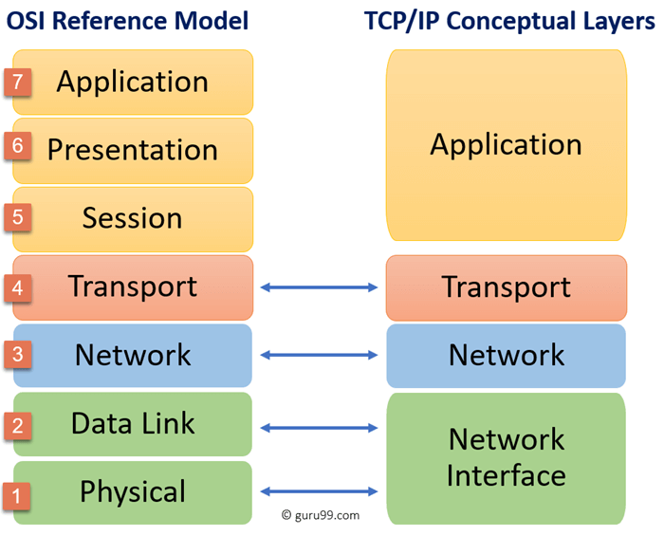
TCP/IP (Transmission Control Protocol/Internet Protocol)
TCP/IP is the foundation of data communication for the Internet. It manages the connection between client devices and the Vercel server, ensuring reliable data transmission.

